Slide 1
Ready

Slide 2
History Of Ironman
CSIS 1020
Ages 11-19

Slide 3
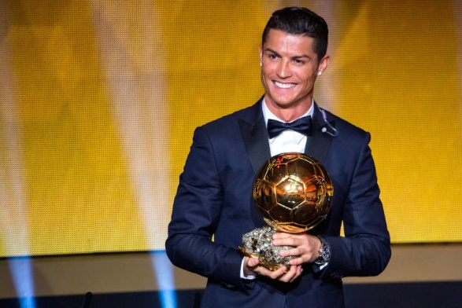
Who is the fittest?
Tom Brady
Cristiano Ronaldo

Slide 4
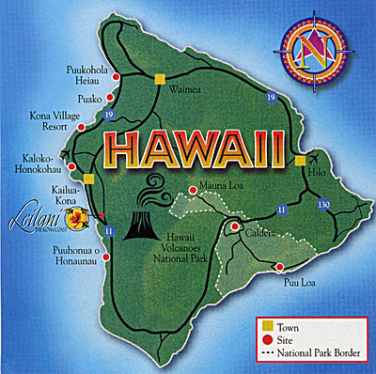
HISTORY OF IRONMAN
Notes:
Back in 1978, Swim Waikiki Club

Slide 5
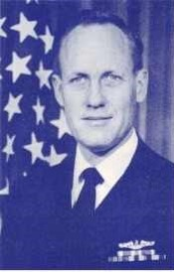
Commander U.S. Navy IRONMAN Founder John Collins

Slide 6
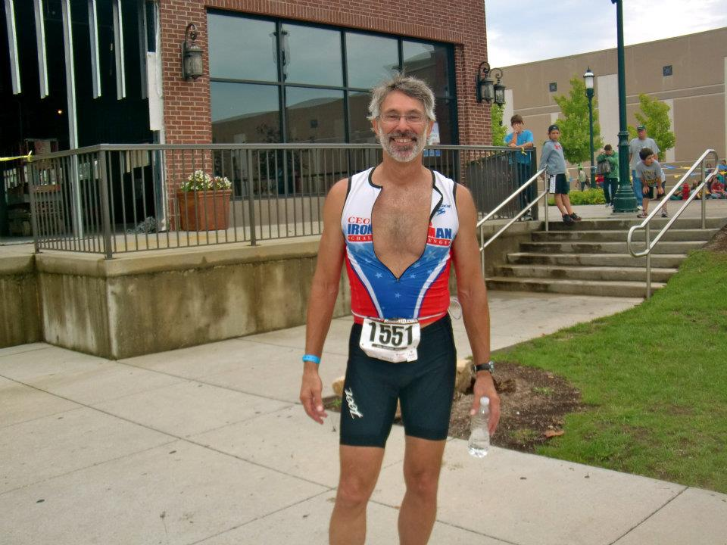
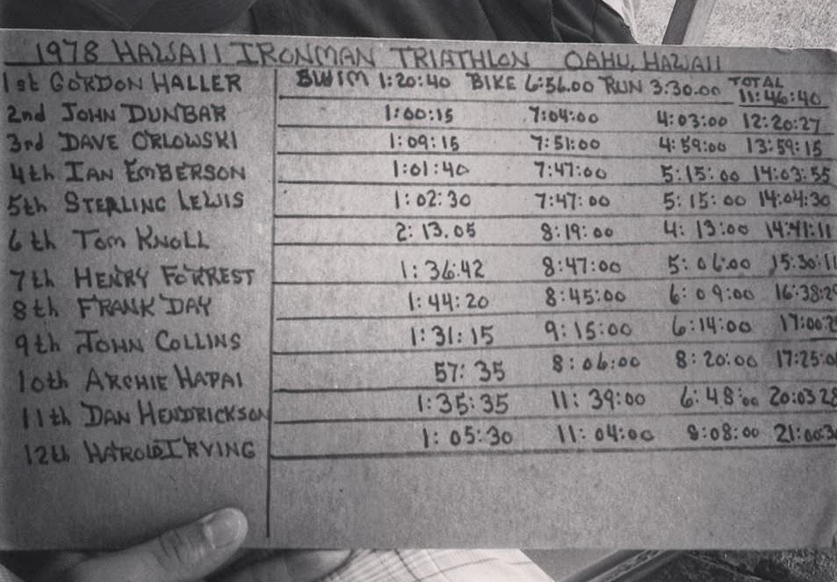
Original Ironman Finishers Feb. 19, 1978 Hawaii
Gordon Haller
First Ironman
Notes:
15 Started but only 12 finished

Slide 7
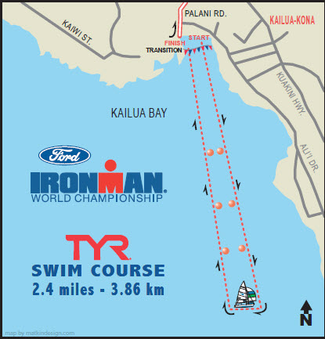
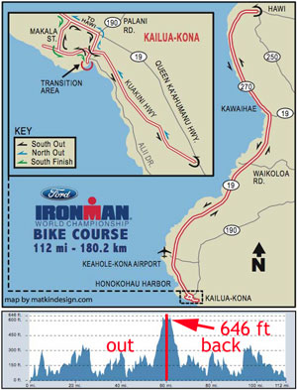
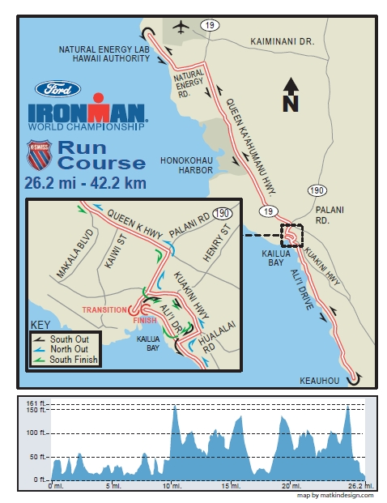
Notes:
Kona

Slide 8
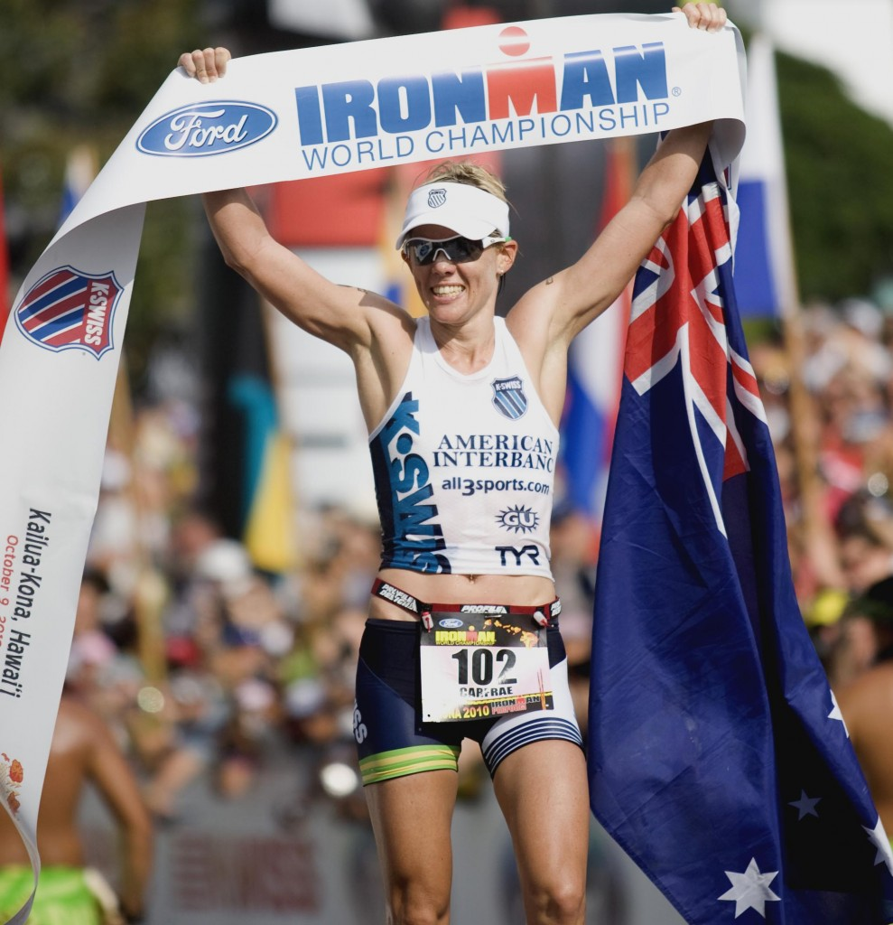
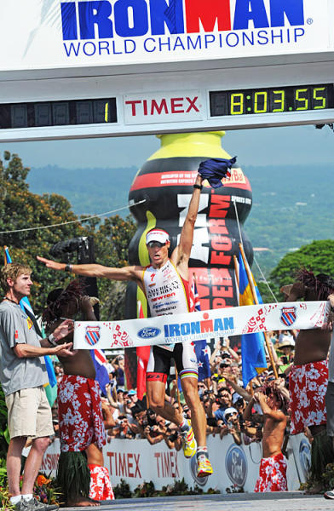
“Swim 2.4 miles! Bike 112 miles! Run 26.2 Miles! Brag for the rest of your life” John Collins
Notes:
Mirinda Carfrea
And Craig Alexander

Slide 9
Triathlon – Sand Hollow – Saint George Rose

Slide 10
Thank You!

